Slide 1
Tracking Women’s Political Empowerment
And Suffrage (1900-2000)
Athena B. Rodrigues
Data Science Department
Undergraduate Capstone Spring 2024

Slide 2
Research Questions
Can women’s political empowerment be categorized and reflect the changes in nation-state building, modernization, and gender equality over the 20th Century?
What trends emerge from the mapping of these categories and how do changes in women’s suffrage influence these categorizations?
Does this mapping method showcase any regional patterns in women's political empowerment or suffrage?
1
2
3
Notes:
The goal of this project is to analyze women’s progression internationally in the political realm over 100 years.
The main ideas of these questions are:
Can Empowerment be Categorized and Reflect the Development of the 20th Century?
How does Suffrage Impact Empowerment?
Are there Regional Patterns in Empowerment or Suffrage?
Driven and expanded by these three questions, my research focused on finding trends in finding trends in empowerment and suffrage, showcasing the divides between continents, and exploring the impact of cultural identities. The modern-day women’s rights movement, which originated from the Suffragettes of the early 1900s, adapted to the post-colonial world of the 1950s, radicalized in the 1970s, and modernized in the 1990s continues to evolve to expand its reach and influence. Empowerment has been a century-long journey that must continue to be studied to better understand and appreciate gender rights progression into the new millennium.

Slide 3
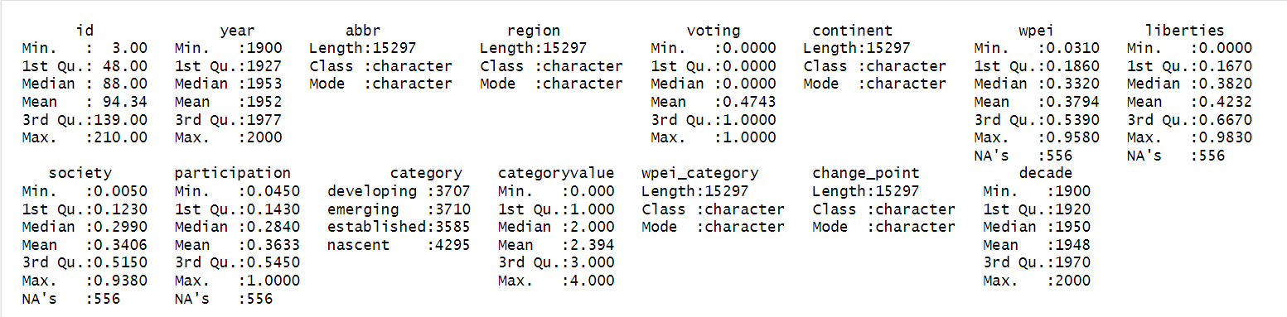
‘Combined’ Data Set
*Summary Table does not take into account the structure and meaning of data

Slide 4
Data Variables
Geographic
WPEI
Year
Nation Name, Abbreviation, Unique ID Number, Continent
Index Number
between 0 and 1
1900 to 2000
Timeframe
Civil
Liberties
Civil
Society
Political Participation
Category
Voting
Change Points
Created Empowerment Category and Corresponding Number Value
Suffrage Determined through
0 (no suffrage) or 1 (suffrage)
Determines whether a change in empowerment or in voting has occurred between the previous year
Notes:
Geographic: Most of the geographic data is found using the maps R package. Continents were found using iso3c country codes which linked to the given V-Dem country codes
WPEI: The actual index values
Year: The 20th Century is considered the era of nation-states and modernization which greatly impacted the geopolitical landscape of the time. This 100 year time span saw the creation of over 100 countries and a prioritization of the new cultural and social identities while forgetting about equality and freedoms for all humans.
Voting: originally was between 0 and 100 taking into account limited impacts but was simplified to 0 or 1. This resulted in a greater empowered female population who continued to push barriers and advance women’s political standing. Through integrating suffrage there is better context for the building and overall analysis of tracking women’s empowerment.
Category: The category variable was created to categorize each nation into an empowerment category. A numeric representation was also added for graphing purposes.
Change Points: This variable indicates the changes in voting for each nation for each year. If women in a nation received or were stripped of the right to vote the change point keeps track of this.

Slide 5
Main R Packages Used
ggplot2
vdemdata
maps
Visualizations
WPEI Data, Sub-Indices Data, Voting Data, Country Data
Geographic Polygons
Adjustments of Some Names
tidyverse
gganimate
plotly
Basic abilities
GIF creation
Interaction of Visualizations

Slide 6
Women’s Political Empowerment
“a process of increasing capacity for women, leading to greater choice, agency, and participation in societal decision-making”
Sundstrom et al.

Slide 7
Women’s Political Empowerment Index
Measures overall political empowerment over 100 years (1900-2012)
Contains three sub-indices for over 170 countries
Provides the most comprehensive and best-covering measure of empowerment
Takes into account newly formed countries, shifting central concepts of women’s rights, and a better representation of the Global South
Notes:
Created by Aksel Sundstron, Pamela Paxton, Yi-Ting Wang, and Staffan I. Lindberg for the V-Dem Institute, the Women’s Political Empowerment Index combines information from three calculated indices about women’s political and civil society progress and combines them into one index that measures overall political empowerment. With data spanning over 100 years (1900-2012), an index of three varieties, and over 170 countries, this index provides the most comprehensive and best-covering measure of empowerment.

Slide 8
Three Sub-Indices
Civil
Liberties
Civil
Society
Political
Participation
Freedom of domestic movement
Freedom from forced labor
Property rights
Access to justice
Freedom of discussion
Participation in Civil Service Organizations
Percentage of female journalists
Power distribution by gender
Political position representation
Presence of women in legislature

Slide 9
Empowerment Categories
Category | Range
Nascent | WPEI ≤ 0.188
Emerging | 0.188 ≤ WPEI ≤ 0.336
Developing | 0.336 ≤ WPEI ≤ 0.546
Established | WPEI ≥ 0.546
Notes:
The split points are the points in the WPEI where the data can be broken into similar groups. These split points were found using the Quantile Method which allowed a category value to be added to the data created through grouping based on quantiles. While originally split into three, four categories provides a broader understanding of empowerment preventing the deflation of newly formed and inflation of existing countries.

Slide 10
Empowerment Categories over the Decades
Notes:
This image rotates through each decade of the 20th century and shows empowerment categories for the present nations or colonies. Through this view one can see the rapid development of the North and the “wave of establishment” in the later decades.

Slide 11
Correlation between Indicators by Category
Category | Civil Society and Civil Liberties | Civil Society and Political Participation | Civil Liberties and Political Participation
Nascent | -0.07942348 | 0.05531654 | -0.1336073*
Emerging | -0.22664845 | -0.10028010 | -0.6189087*
Developing | -0.07360711 | -0.09743562 | -0.6376153*
Established | 0.43980447* | 0.34631430* | -0.1018835
Notes:
Countries in the Nascent Period saw a decrease in their political participation as civil liberties increased.
Countries in the Emerging and Developing Countries see a tradeoff between liberties and participation.
Countries in the Established category see greater societal participation improvements coupled with increased civil liberties and political participation. This can be understood as better access to participate when granted more freedoms and political power.
All significant relationships show a downward trend once granted greater freedoms showing the cyclical nature of women’s rights initiatives.

Slide 12
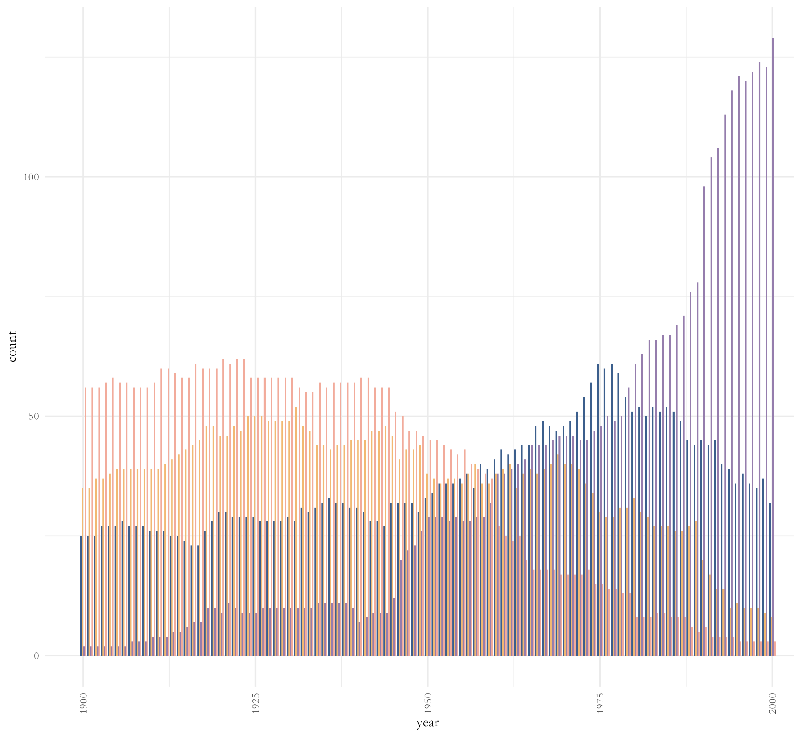
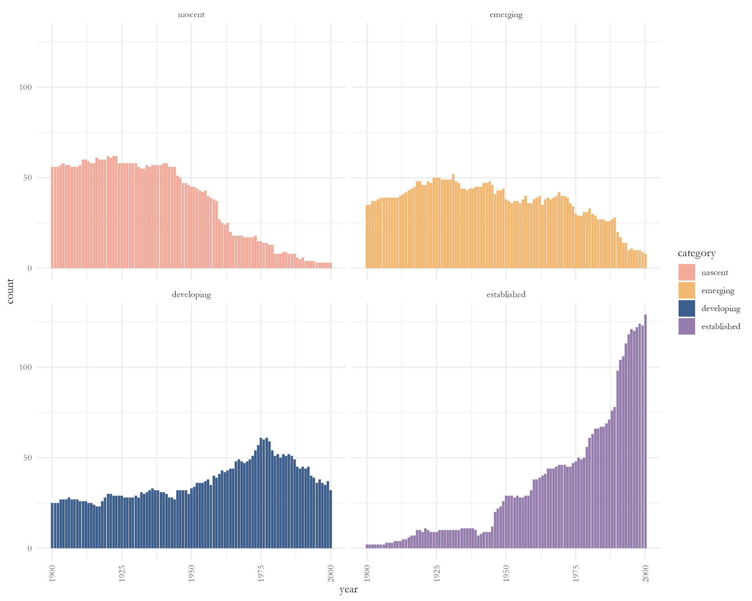
Empowerment Periods Graph
Notes:
This graph was created by using category counts for each year. The peak years represent the height of that category’s period and the range can be determined through the upward and downward trends in relation to the other categories. Below are both the combined and separated empowerment graphs that show the trends of empowerment categories.

Slide 13
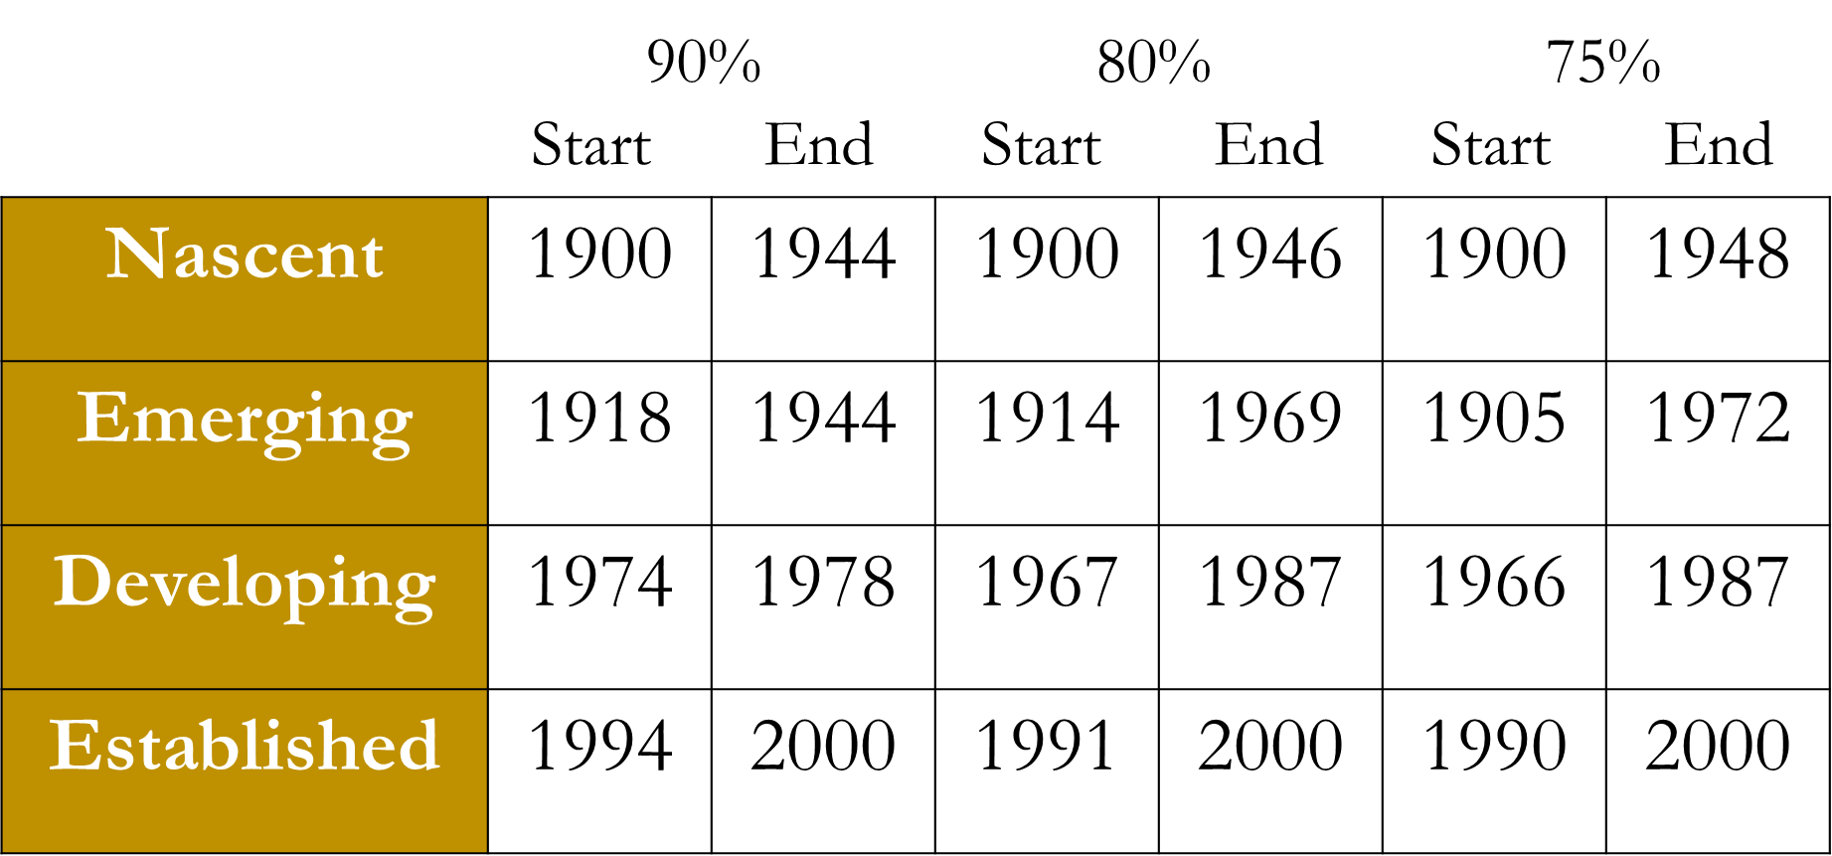
Empowerment Periods Thresholds
Notes:
To confirm the visual findings threshold calculations at 75%, 80%, and 90% were calculated and evaluated to find an exact range of years. The higher the threshold the more selective the parameters for category consideration are. Ultimately, the 90% threshold was leaned heavily on when determining year ranges as it was stricter in its criteria for inclusion. There was still influence by the results of the other calculations when determining category ranges to better smooth the data over time.

Slide 14
Empowerment Periods
Period | Years
Nascent | 1900 – 1955
Developing | 1956 – 1978
Established | 1979 - 2000
Notes:
Both methods showed the emerging category restrained with little majority compared to the other categories. Because of this, it was decided to condense the emerging category for the determination of Empowerment Periods resulting in the previously desired three-period analysis. When factoring in the empowerment period, the results do significantly match the graph takeaways. The emerging period was still kept for the other areas of this project as the three quantile distributions significantly weekend the overall category breakdown. With this condensation, the Empowerment Periods were determined.

Slide 15
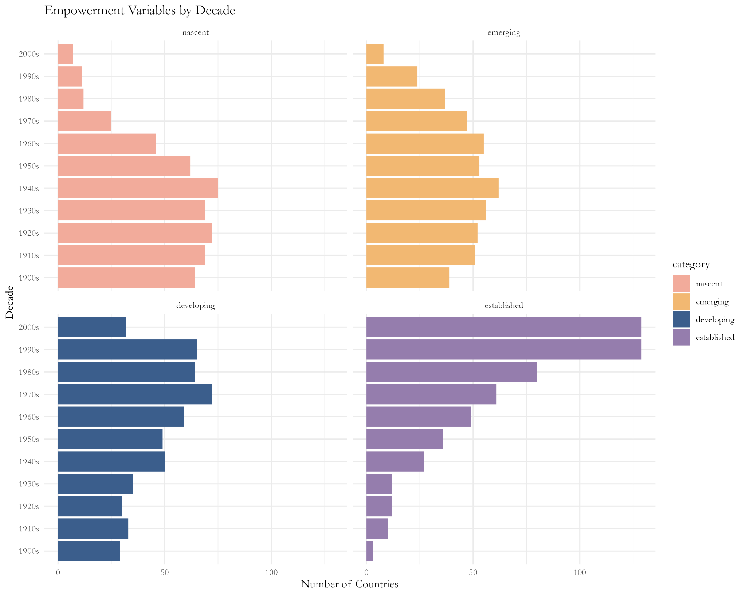
Empowerment over the Decades

Slide 16
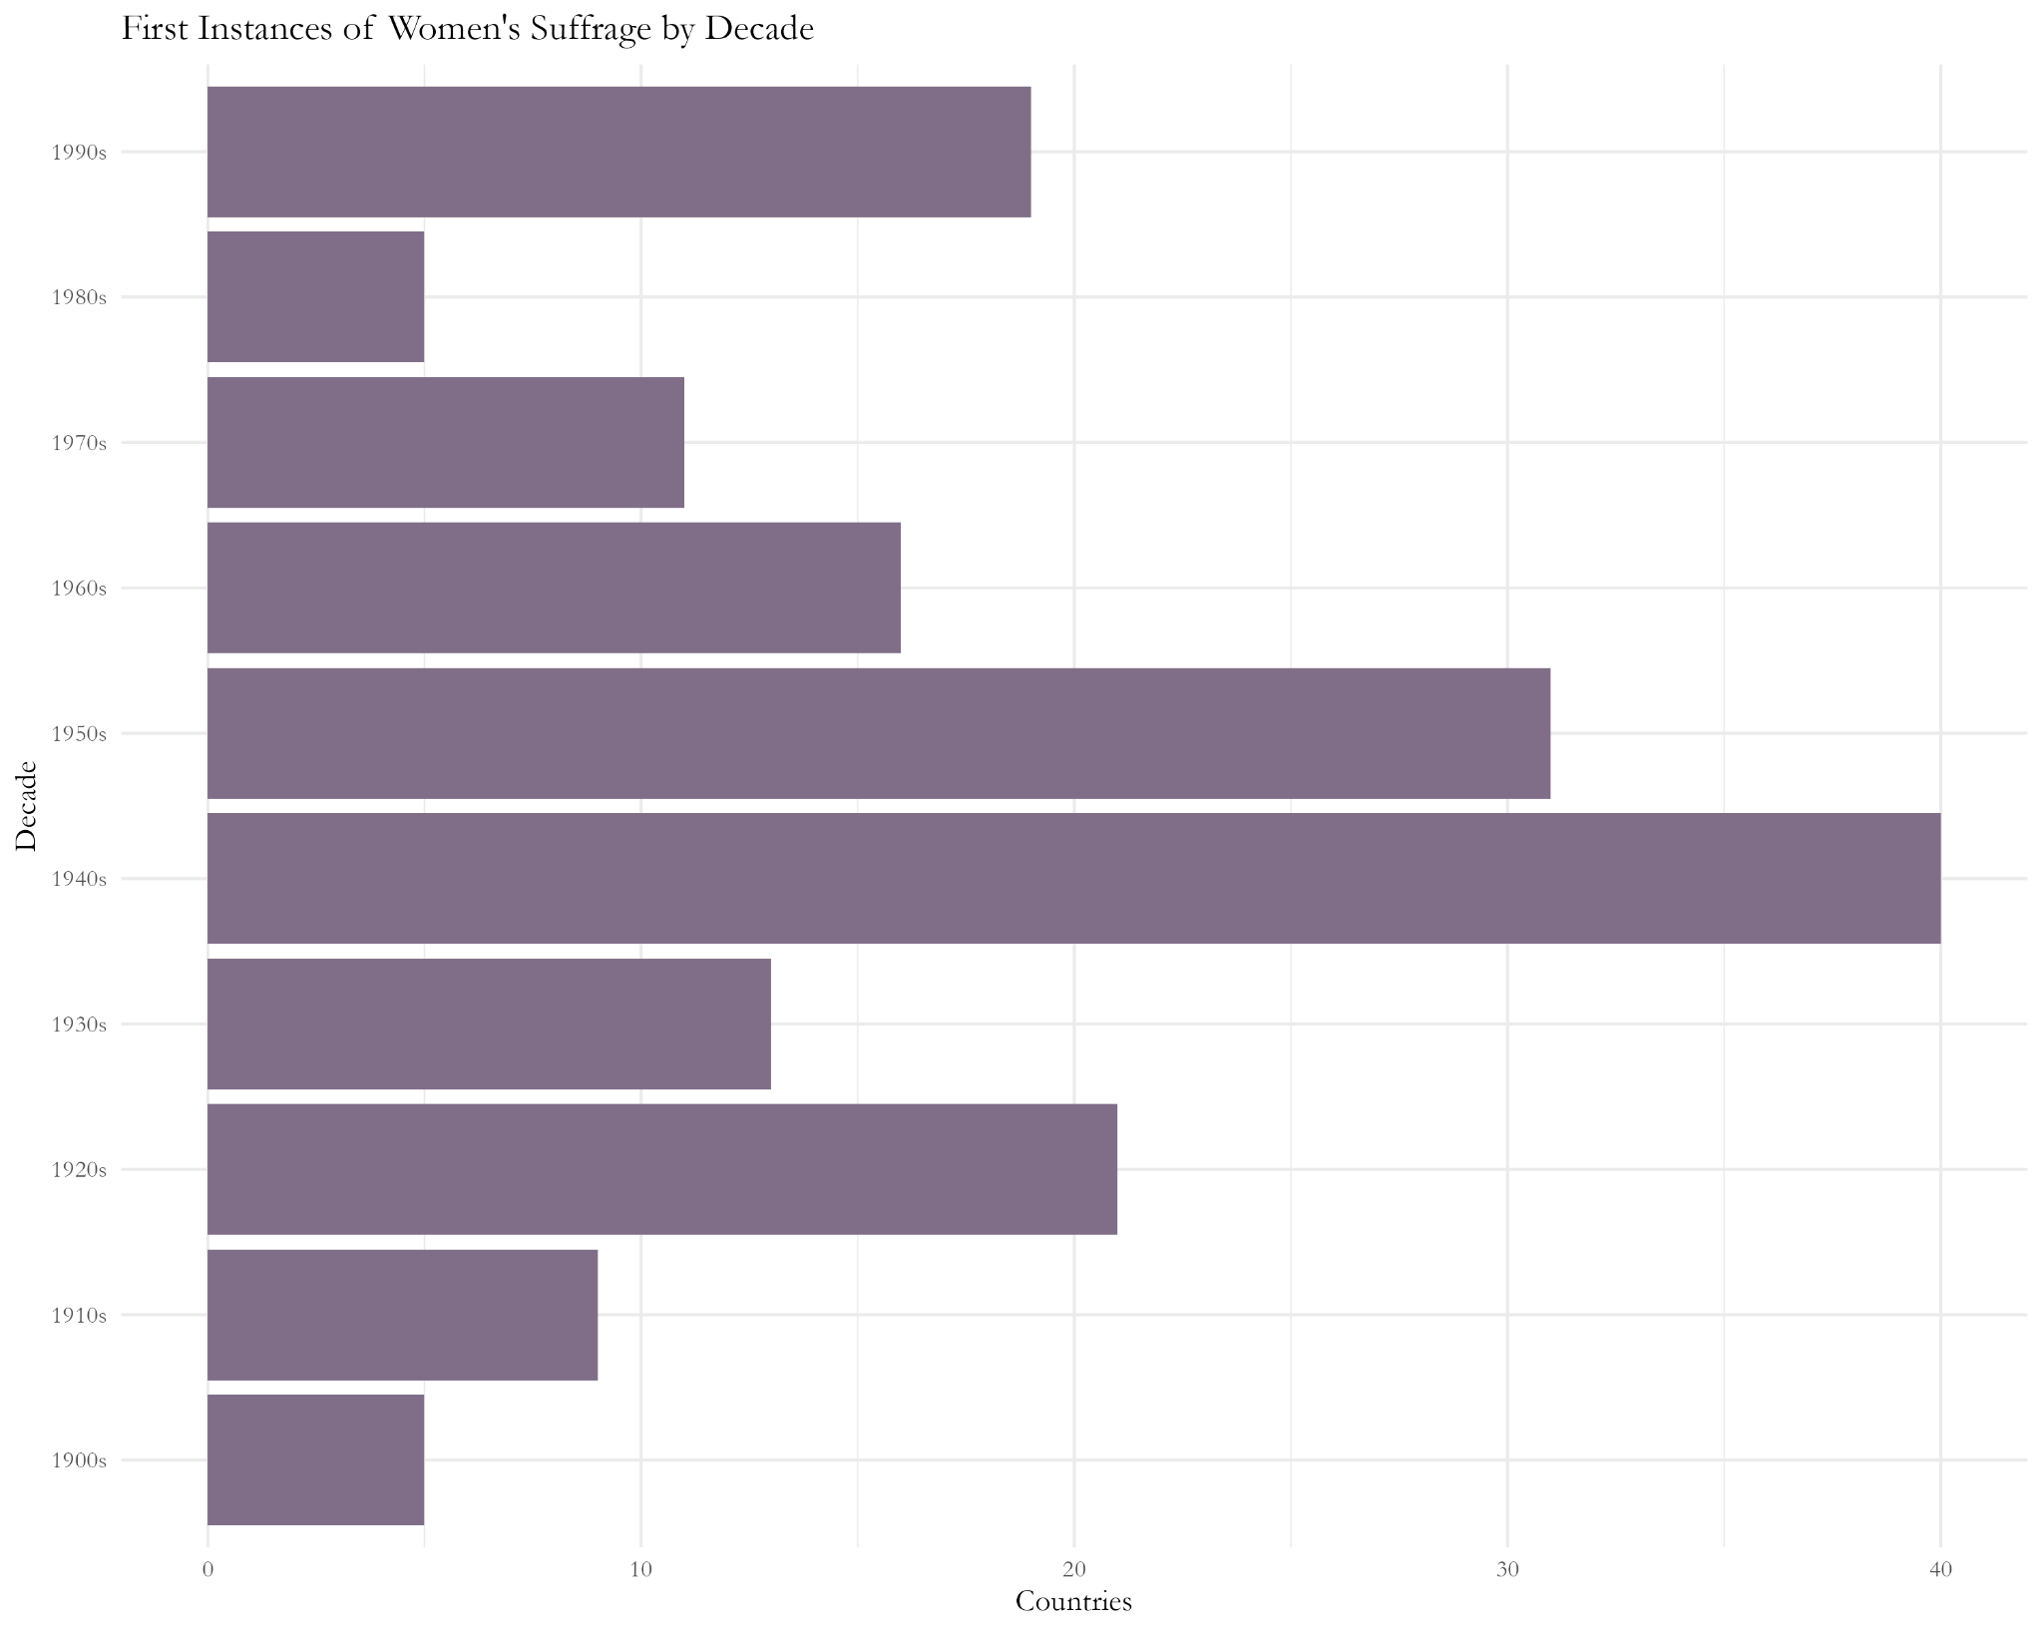
Suffrage over the Decades
Notes:
PROCESS TO FIND THIS
The 40s and 50s show the highest number of first suffrage instances. This can be attributed to the period of decolonization and the emergence of the majority of African and Asian nation-states. The increase of the 20s represents the suffrage movements of the “West” while the spike in the 90s represents the breakup of the Soviet Union and Yugoslavia. It is interesting how regional changes, more specifically nation-building, can be tracked through suffrage. This also can be drawn into the Empowerment Periods with some of the highest decades of first suffrage tracking along with the empowerment category breaks.

Slide 17
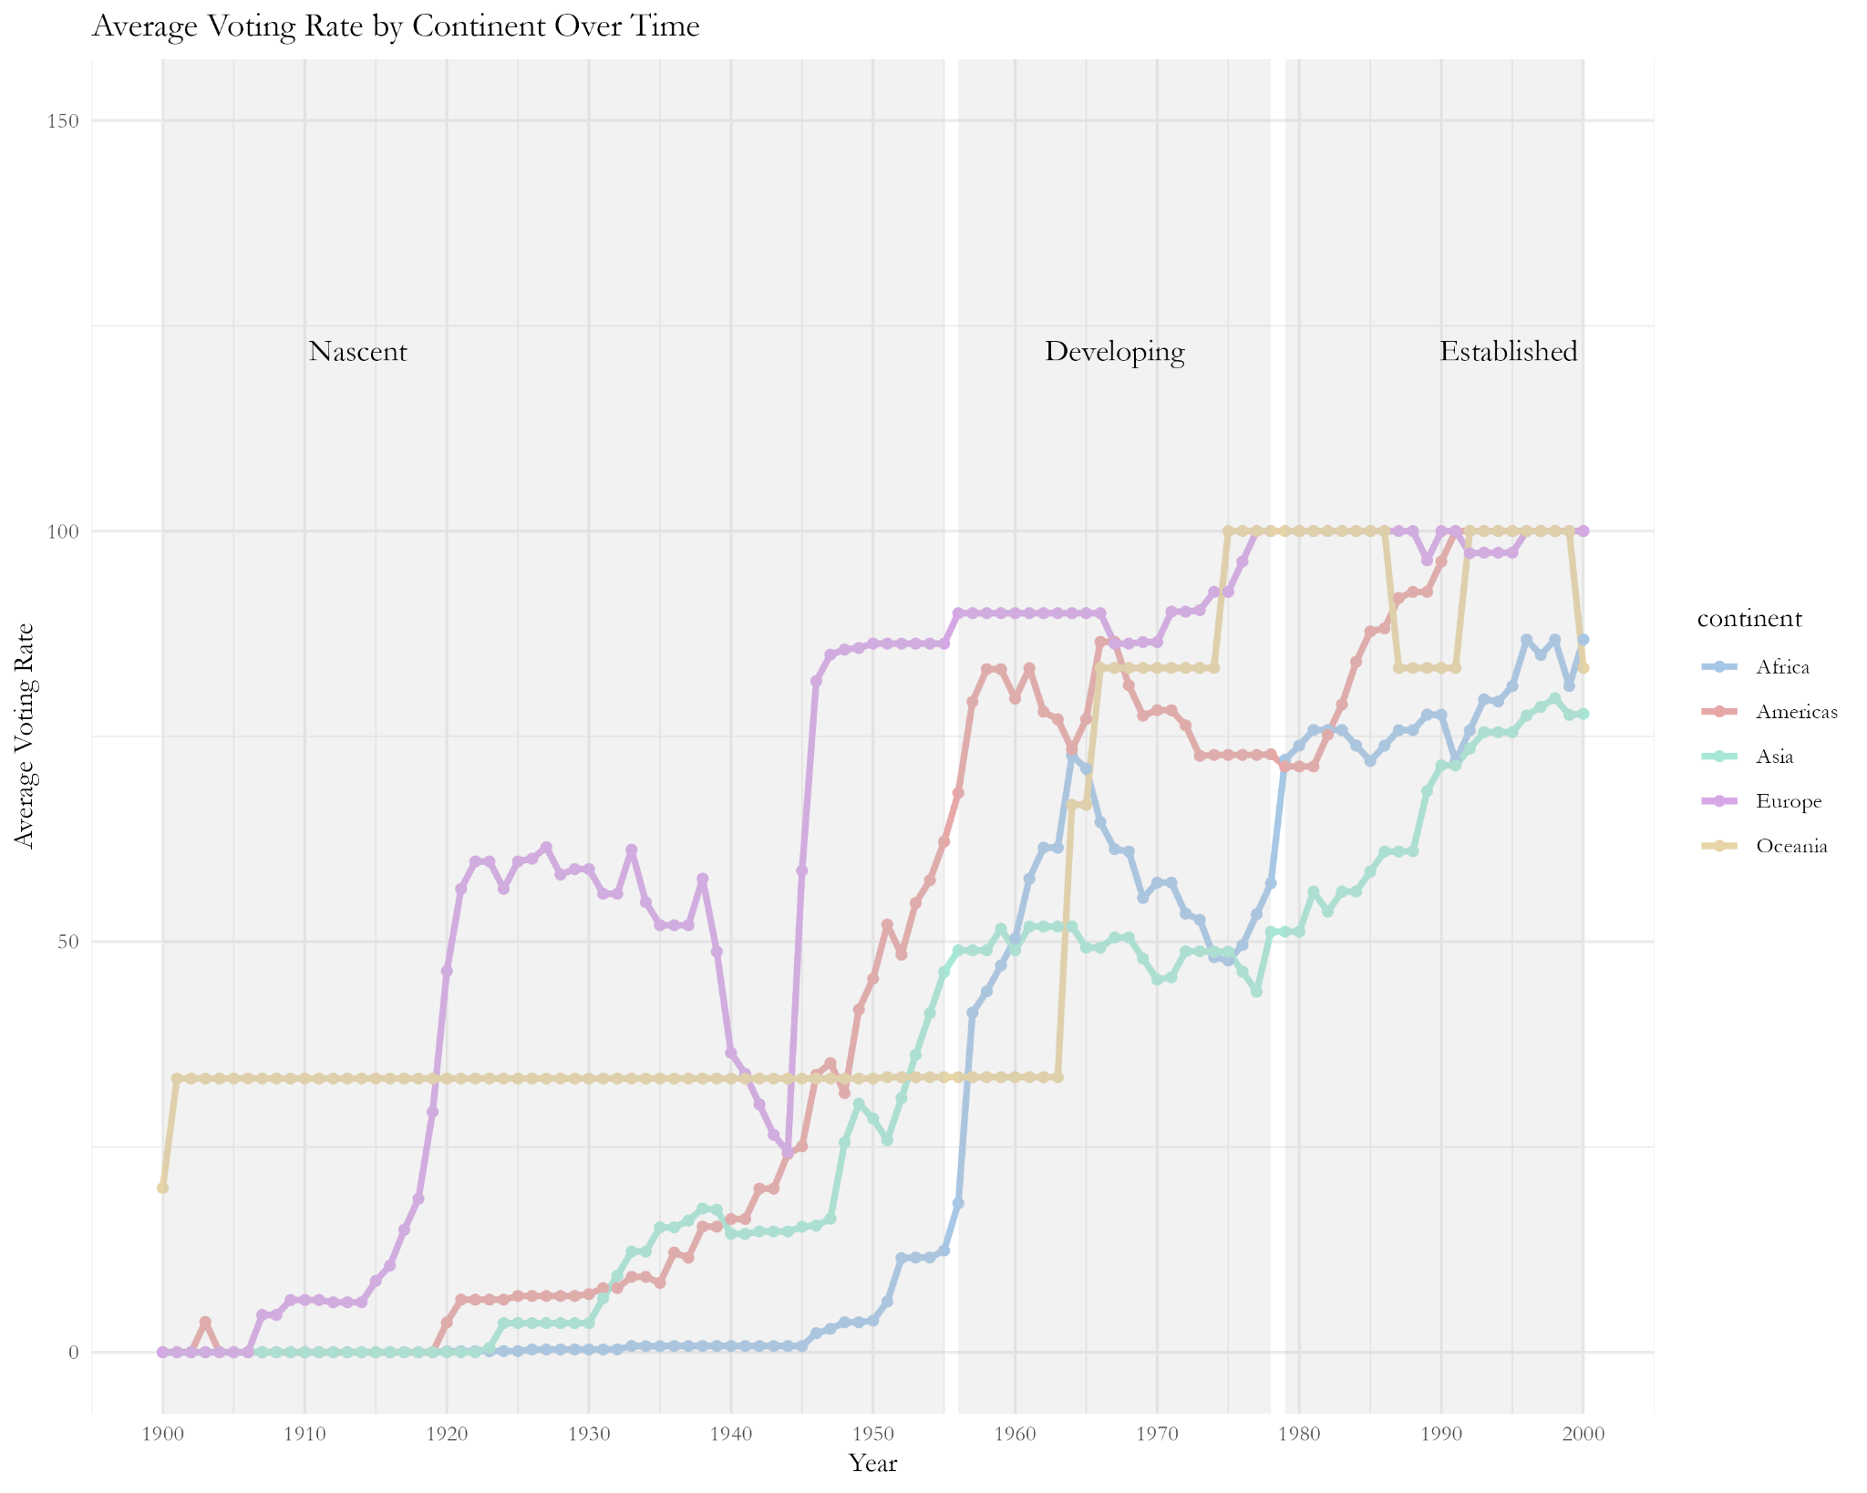
Suffrage by Continent
Notes:
PROCESS TO FIND THIS
The Global North divide can be seen with Europe quickly reaching suffrage for over half of its countries by the 1940s while the Americas, Asia, and Africa did not see steady growth until this time. The rise and fall of Africa and the Americas from the 60s into the 80s represent the regime shifts and coups that plagued these areas during the period. This representation of the voting rate over time provides the best representation of the voting fluctuations.

Slide 18
Further Research Topics
Pre-World War versus Post-World War
Before Decolonization versus After DeColonization
Global North versus Global South
Impact of Historic Events in Women’s History
Notes:
The main areas I would focus on for further research deal with social and cultural divides. Still seen today, there has been a significant divide between the “First and Second World” of North America and Europe and the “Third World” of Africa, Asia, and South America. Much of this can be traced back to the age of colonization as these “Third World” countries were exploited and placed under the prior’s control resulting in large discrepancies for research purposes due to lacking efforts in these areas. Further research would explore the impact of this divide on a country’;s suffrage and empowerment scores.

Slide 19
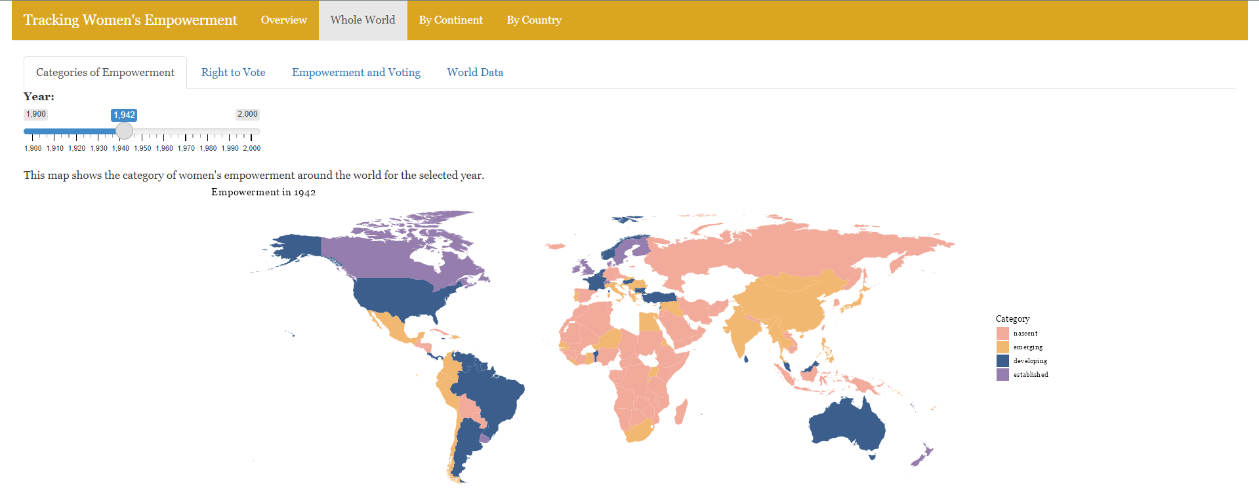
The Dashboard
Notes:
PROCESS TO CREATE THIS
The culmination of my work occurs through a Shiny App Dashboard which unfortunately cannot be shared due to storage restrictions on the basic account. Seen in this screenshot is the combined world map which showcases empowerment categories and voting rights using a slider to choose a desired year. Along with this combined map are separate maps for empowerment and voting. There is also continent divided maps and country specific maps for these topics. An Overview Panel provides greater information on the Empowerment Index, how the Empowerment Levels and Periods were formed, insights and analysis of the data set, and potential further research questions and challenges.

Slide 20
References
Sundström, A., Paxton, P., Wang, Y. T., & Lindberg, S. I. (2017). Women&#39;s political empowerment: A new global index, 1900–2012. World Development, 94, 321-335.
Coppedge, Michael, John Gerring, Carl Henrik Knutsen, Staffan I. Lindberg, Jan Teorell, David Altman, Fabio Angiolillo, Michael Bernhard, Cecilia Borella, Agnes Cornell, M. Steven Fish, Linnea Fox, Lisa Gastaldi, Haakon Gjerlow, Adam Glynn, Ana Good God, Sandra Grahn, Allen Hicken, Katrin Kinzelbach, Joshua Krusell, Kyle L. Marquardt, Kelly McMann, Valeriya Mechkova, Juraj Medzihorský, Natalia Natsika, Anja Neundorf, Pamela Paxton, Daniel Pemstein, Josefine Pernes, Oskar Rydén, Johannes von Römer, Brigitte Seim, Rachel Sigman, Svend-Erik Skaaning, Jeffrey Staton, Aksel Sundström, Eitan Tzelgov, Yi-ting Wang, Tore Wig, Steven Wilson and Daniel Ziblatt. 2024. ”V-Dem [Country-Year/Country-Date] Dataset v14” Varieties of Democracy (V-Dem) Project. https://doi.org/10.23696/mcwt-fr58.
Pemstein, Daniel, Kyle L. Marquardt, Eitan Tzelgov, Yi-ting Wang, Juraj Medzihorský, Joshua Krusell, Farhad Miri, and Johannes von Römer. 2024. “The V-Dem Measurement Model: Latent Variable Analysis for Cross-National and Cross-Temporal Expert-Coded Data”. V-Dem Working Paper No. 21. 9th edition. University of Gothenburg: Varieties of Democracy Institute.

